Slide 1


Upper Coastal Plain Rural Planning Organization (UCPRPO)
TCC Meeting
September 14, 2021
Edgecombe County - Johnston County – Nash County – Wilson County
The meeting will begin at 2:00 PM
Please mute your line if you have not already done so.

Slide 2
UCPRPO TCC Meeting
Edgecombe County - Johnston County – Nash County – Wilson County
September 14, 2021
Meeting Guidelines
Please keep your microphone on mute until you are ready to make a comment or ask a questions.
Turn your microphone on to speak but remember to turn it off once you have finished.
Begin with stating your name so everyone will know who is speaking.
You may use the chat feature to send a note. The chat will be checked, but please get my attention if I fail to respond quickly.
All votes will be completed by roll call as per NCGS 166A-19.24(b)(5). When the chair calls for a vote, I will call roll and ask each person to respond with a ‘yes’ or ‘no’.
Please remember to mute yourself again after roll call.
Please keep microphone muted
Chat is enabled

Slide 3
UCPRPO TCC Meeting
Edgecombe County - Johnston County – Nash County – Wilson County
September 14, 2021
1. Welcome & Introductions – James Diggs – TCC Chair
ROLL CALL
2. REVIEW AGENDA FOR ADDITIONS OR CORRECTIONS

Slide 4
UCPRPO TCC Meeting
Edgecombe County - Johnston County – Nash County – Wilson County
September 14, 2021
3. APPROVAL OF UCPRPO TCC MEETING MINUTES
Review and approval of the July 13, 2021 minutes with a motion and second….. Then roll call

Slide 5
UCPRPO TCC Meeting
Edgecombe County - Johnston County – Nash County – Wilson County
September 14, 2021
4. Member updates from members around the Region
Roll call will be completed to allow each member an opportunity to provide updates from each member jurisdiction.
EDGECOMBE
JOHNSTON
NASH
WILSON

Slide 6
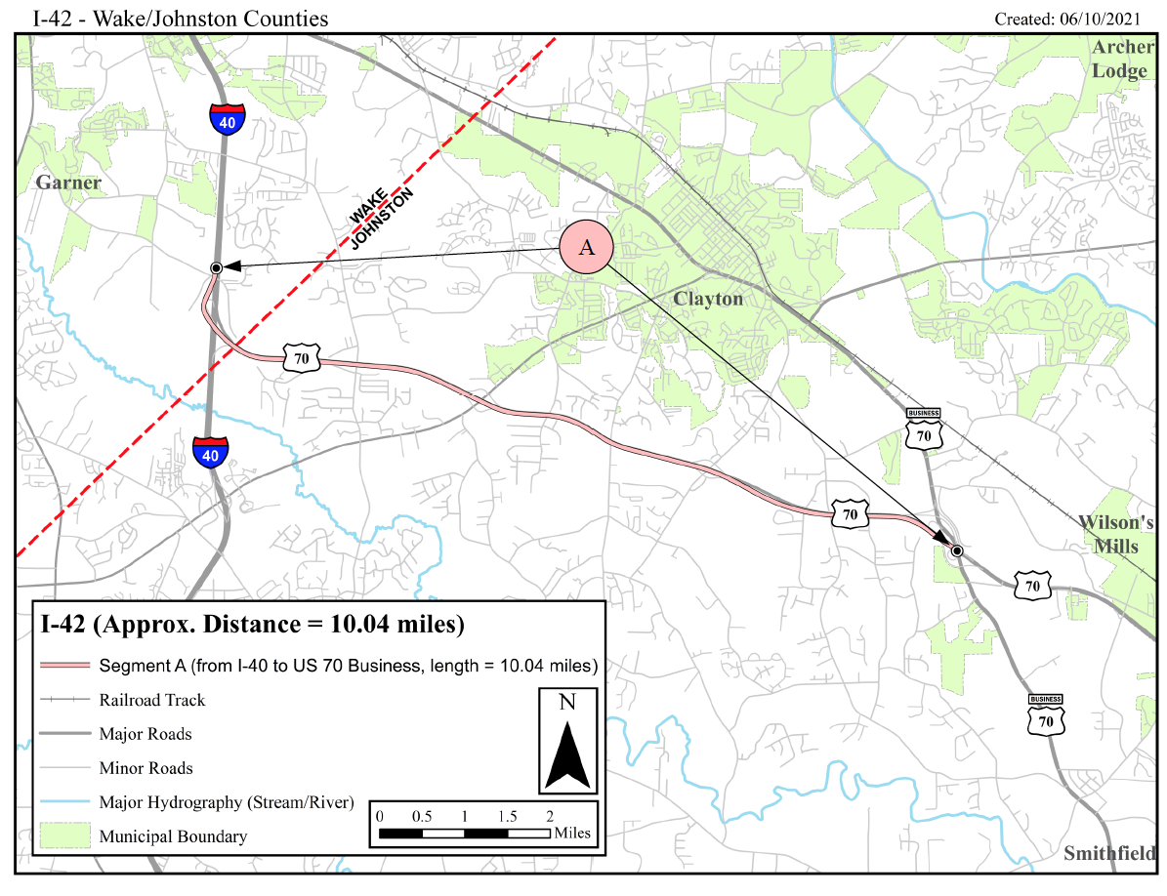
UCPRPO TCC Meeting
Edgecombe County - Johnston County – Nash County – Wilson County
September 14, 2021
5. Adopt Resolution of Support to Designate US 70 as I 42 in Johnston County
As part of upgrading
US 70 to Interstate
Standards, NCDOT
Would like to
Designate US 70
as I 42
Seeking Motion
With Second and
Then Roll Call……

Slide 7
UCPRPO TCC Meeting
Edgecombe County - Johnston County – Nash County – Wilson County
September 14, 2021
6. Letter of Support for FY2022 – 5310 Funding for Johnston County Industries
Johnston County Industries provides transportation services in conjunction with JCATS for employment and training opportunities and access to community resources for individuals with disabilities for over 30 years.
Seek Motion with Second and then roll call………

Slide 8
UCPRPO TCC Meeting
Edgecombe County - Johnston County – Nash County – Wilson County
September 14, 2021
7. STI Prioritization P6 Update
NCDOT Board of Transportation agreed to halt the STI P6 process. Scoring of all projects will continue and be released in September. Process will not continue with local input.
The following are talking points provided by NCDOT:
- NCDOT established an internal workgroup to look at issues related to rising cost estimates.
1. Necessary because in the last few years, many projects were coming in much more expensive than initial estimates.
2. These increases impact the STIP.
- Cost increases are caused by a variety of things such as:
Estimates were done before projects were fully defined. Automated Cost Estimation Tool didn’t have the capability to include all specific impacts that can increase cost.
1. Estimates were done many years before construction – and costs increased over that time.
2. Recent increases in costs of property, supplies and contractor/consultant rates.

Slide 9
UCPRPO TCC Meeting
Edgecombe County - Johnston County – Nash County – Wilson County
September 14, 2021
7. STI Prioritization P6 Update
NCDOT talking points continued:
- NCDOT identified the issue, and implemented a review of over 450 projects in the STIP.
1. Updated over 1,000 individual estimates (construction, utility relocation, property acquisition)
2. Process nearing completion.
3. Results indicate many projects will be more expensive than initial estimates.
Currently in the process of reviewing non-committed projects.

Slide 10
UCPRPO TCC Meeting
Edgecombe County - Johnston County – Nash County – Wilson County
September 14, 2021
7. STI Prioritization P6 Update
NCDOT talking points continued:
- Cost increases will force NCDOT to adjust the future STIP (2024-2033).
Law requires the STIP to be an accurate reflection of what will be built.
1. STIP must be limited by what revenue NCDOT realistically anticipates.
2. As the cost of projects increases, it decreases the number of projects that can be built or moves projects to a later date when funds will be available.
- Example – if you budget $10 to buy 10 cans of soup, and soup prices increase to$2 per can, you cannot buy the 10 cans you budgeted for – can only buy 5.
3. NCDOT estimated funding levels have not changed, but the price of delivering projects has increased.
4. Estimates are updated regularly to account for inflation.
5. Costs have been rapidly increasing due to our growing economy.
- Example – Associated General Contractors of America are reporting the cost of basic materials has increased by more than 10% so far this year.

Slide 11
UCPRPO TCC Meeting
Edgecombe County - Johnston County – Nash County – Wilson County
September 14, 2021
7. STI Prioritization P6 Update
NCDOT talking points continued:
- The STIP is a planning document and not a fiscal document and this does not jeopardize NCDOT’s financial standing. There are processes in place with many checks and balances that ensure we do not overspend.
- This, also, highlights the ongoing issues with transportation needs outpacing revenue.
- NCDOT is working with MPO/RPOs as the STIP adjustment takes place.
- Because of the cost increases in the updated estimates, the Prioritization Workgroup decided on July 19th to recommend to the Board of Transportation that the next project prioritization cycle (P6.0) be halted during this time.
1. Next draft STIP does not have to be prepared and presented until December 2022.
2. Allows NCDOT time to complete project estimate updates.
3. Allows MPOs/RPOs time to work on this at the local level.
3. Allows workgroup/NCDOT opportunity to continue to evaluate various options for creating the next draft STIP.

Slide 12
UCPRPO TCC Meeting
Edgecombe County - Johnston County – Nash County – Wilson County
September 14, 2021
7. STI Prioritization P6 Update
The STI P6 Workgroup met August 16, 2021 – Meeting Summary
The Workgroup agreed on the following goals:
Have a trustworthy, dependable STIP
Have an opportunity to fund new projects in P7.0
Create a solution that results in funding being available for P7.0 projects (2026-2035 STIP)
Accomplish these goals within appropriate established deadlines
Ensure everyone is heard and can support the direction of the Workgroup
Ensure goals are grounded in federal requirements
Ensure the end result allows NCDOT to leverage grants at the federal level
The Workgroup continues to work through the challenges in programming the STIP. The process is back-and-forth and nothing has been finalized at this point.
The Workgroup will continue to meet monthly through the end of 2021 with the next meeting scheduled for September 21, 2021.

Slide 13
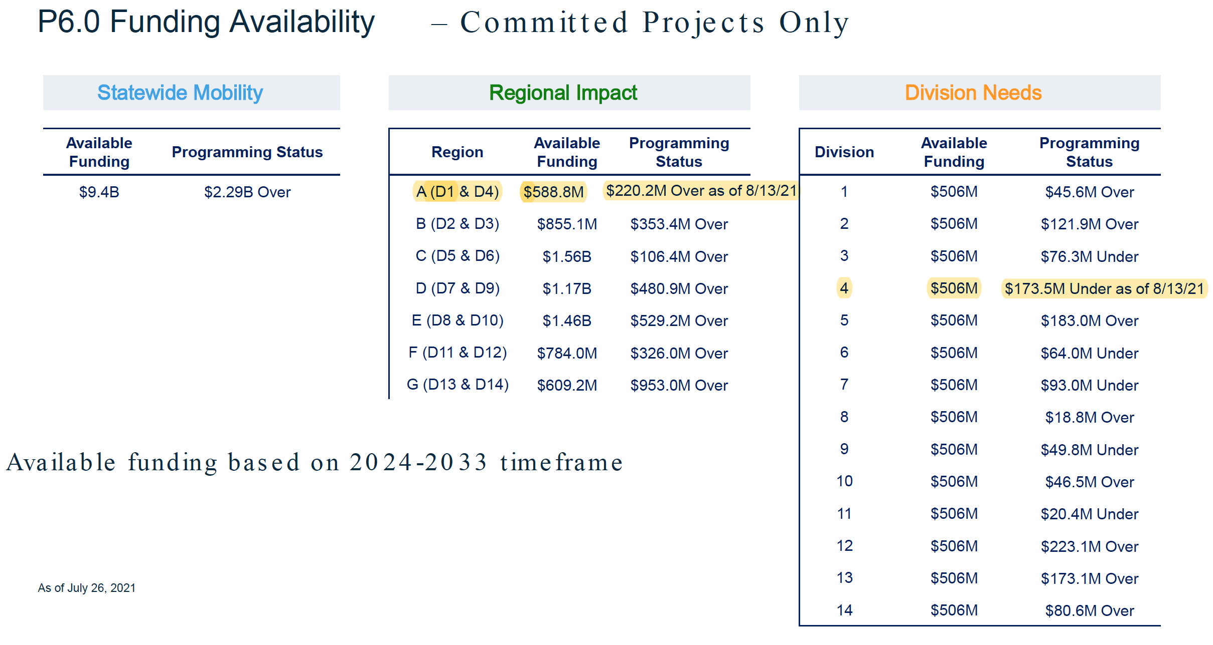
UCPRPO TCC Meeting
Edgecombe County - Johnston County – Nash County – Wilson County
September 14, 2021
7. STI Prioritization P6 Update

Slide 14
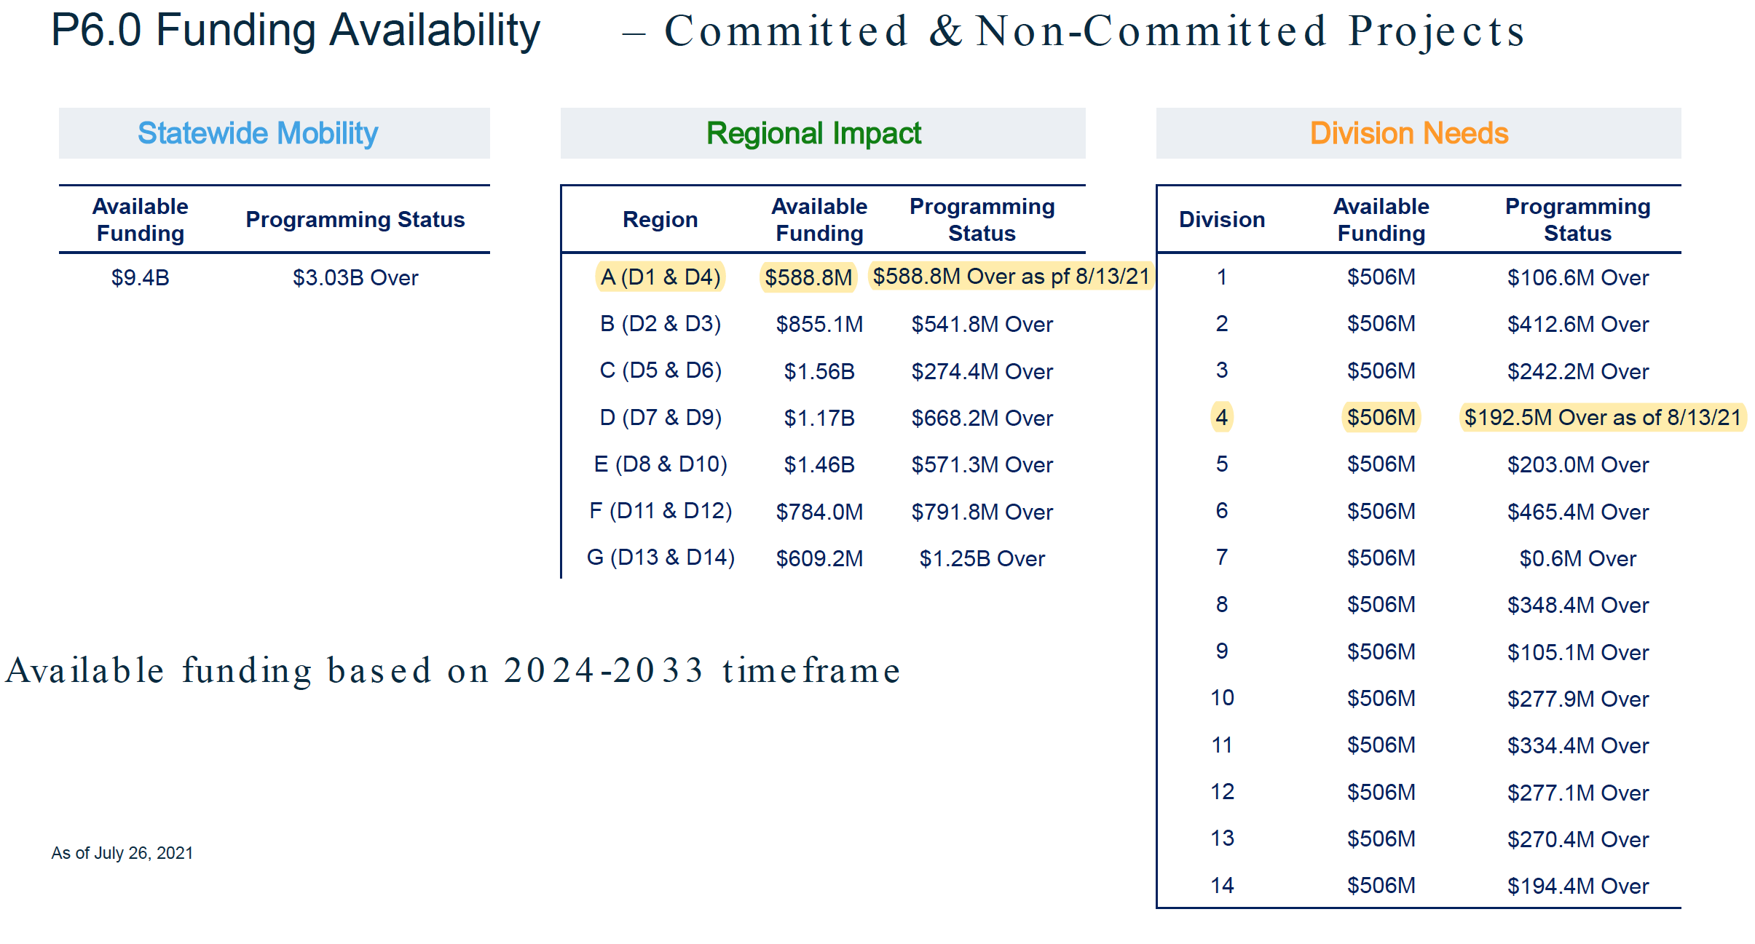
UCPRPO TCC Meeting
Edgecombe County - Johnston County – Nash County – Wilson County
September 14, 2021
7. STI Prioritization P6 Update

Slide 15
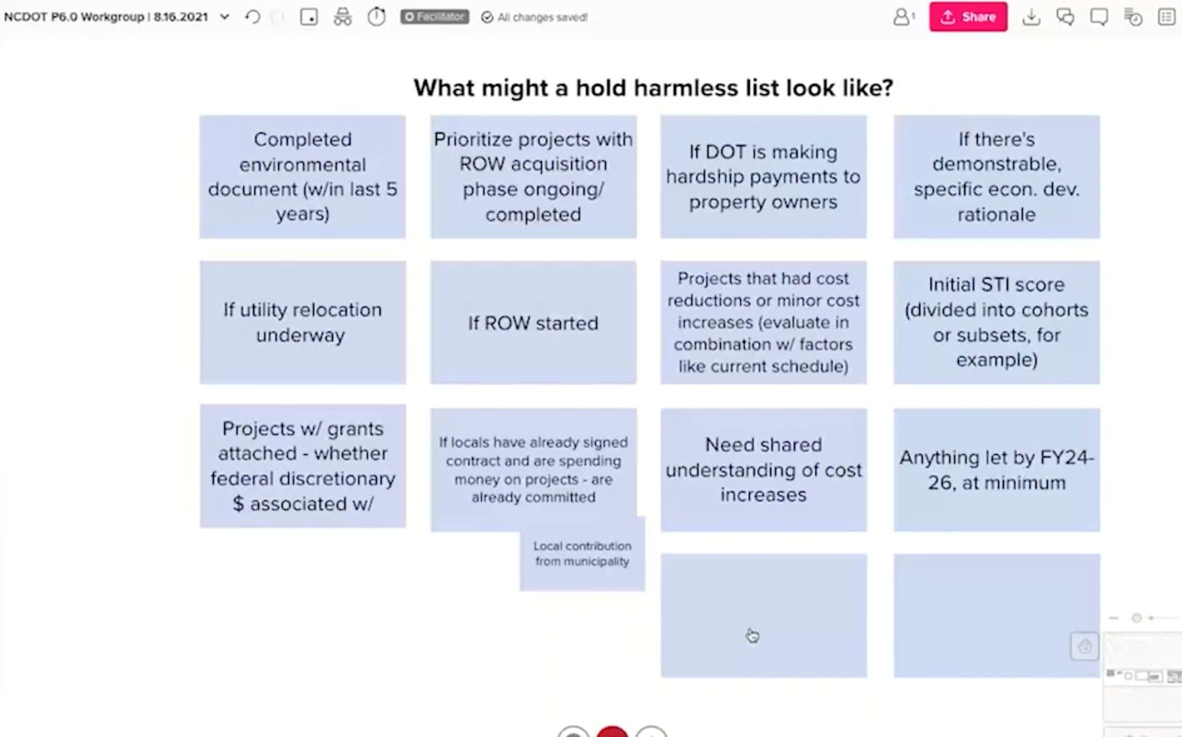


UCPRPO TCC Meeting
Edgecombe County - Johnston County – Nash County – Wilson County
September 14, 2021
7. STI Prioritization P6 Update

Slide 16
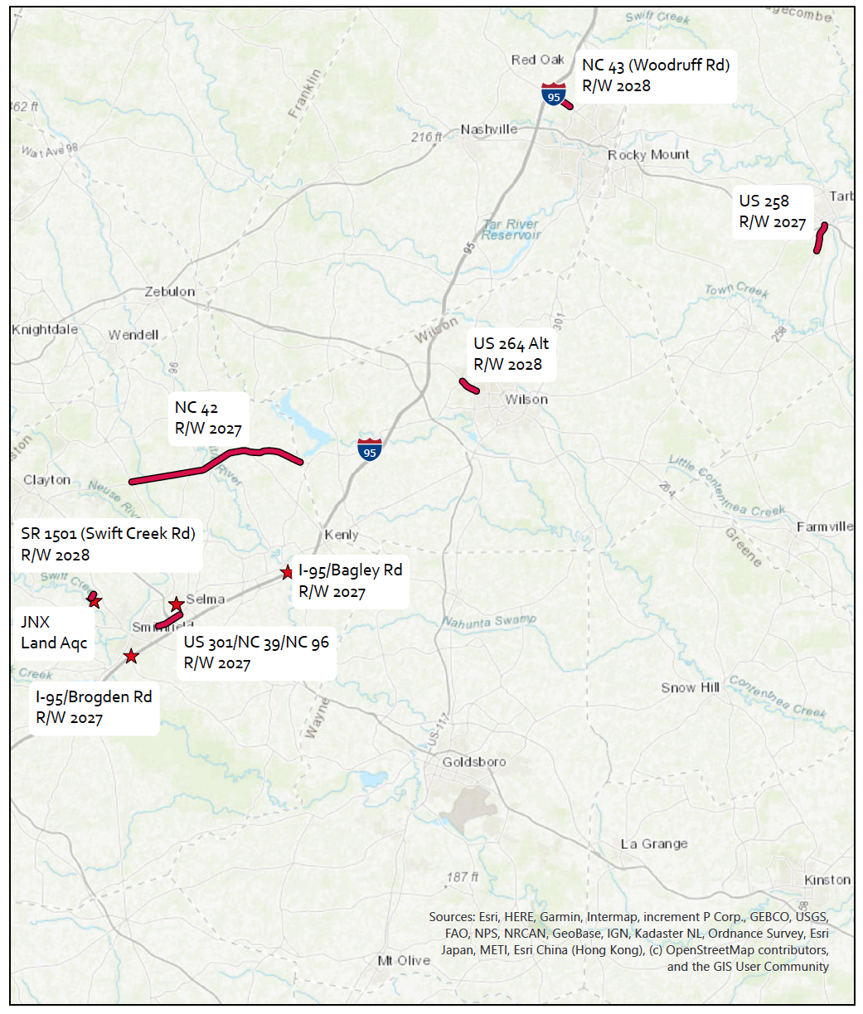
UCPRPO TCC Meeting
Edgecombe County - Johnston County – Nash County – Wilson County
September 14, 2021
7. STI Prioritization P6 Update
Upper Coastal Plain RPO
STI STIP FY2020-2029
Non Committed Projects
Note: List does not include
Non STI projects
i.e. bridge projects
projects under construct
safety projects
pavement rehab

Slide 17
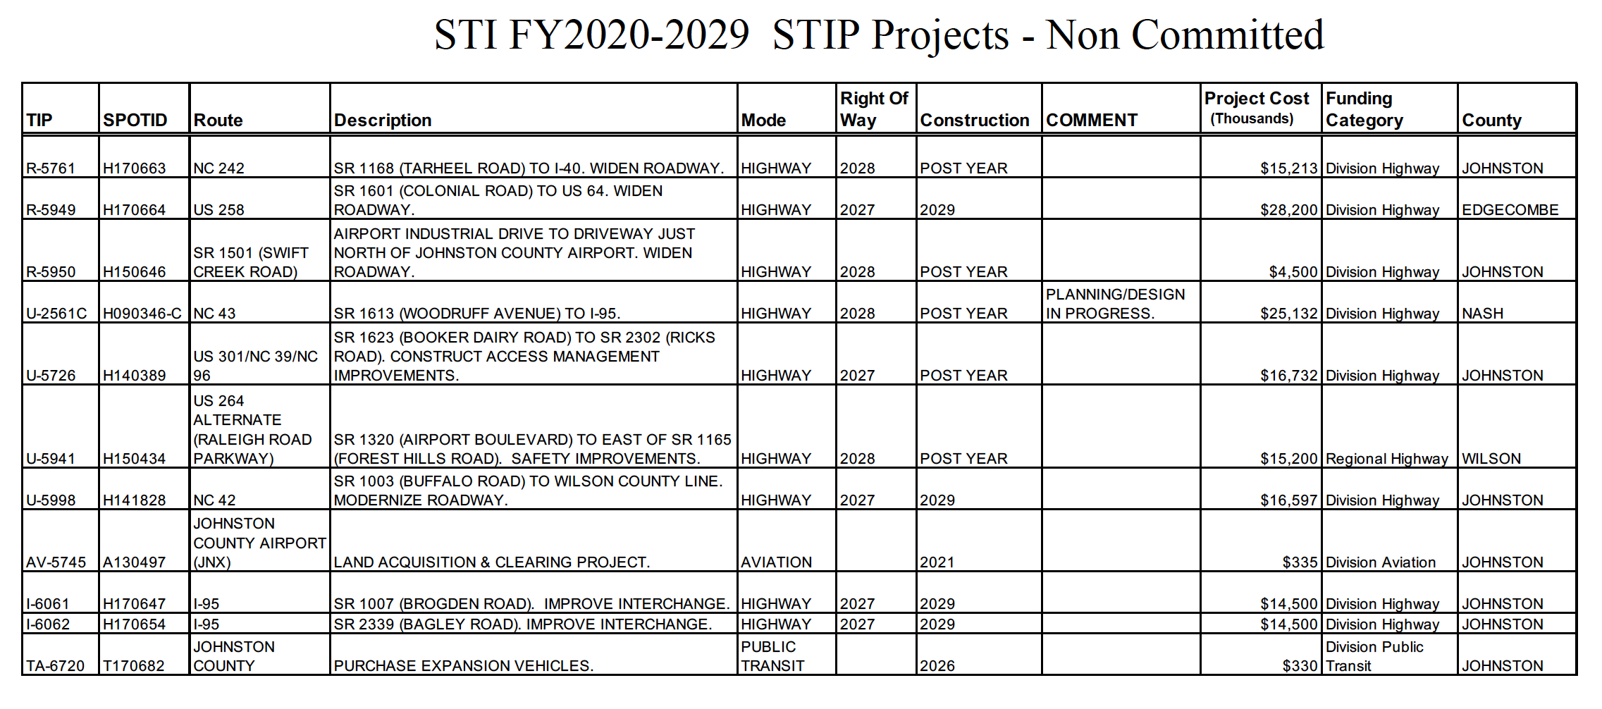
UCPRPO TCC Meeting
Edgecombe County - Johnston County – Nash County – Wilson County
September 14, 2021
7. STI Prioritization P6 Update
Note: List does not include Non STI projects i.e. bridge projects, projects under construction, safety projects, and pavement rehabilitation projects.

Slide 18
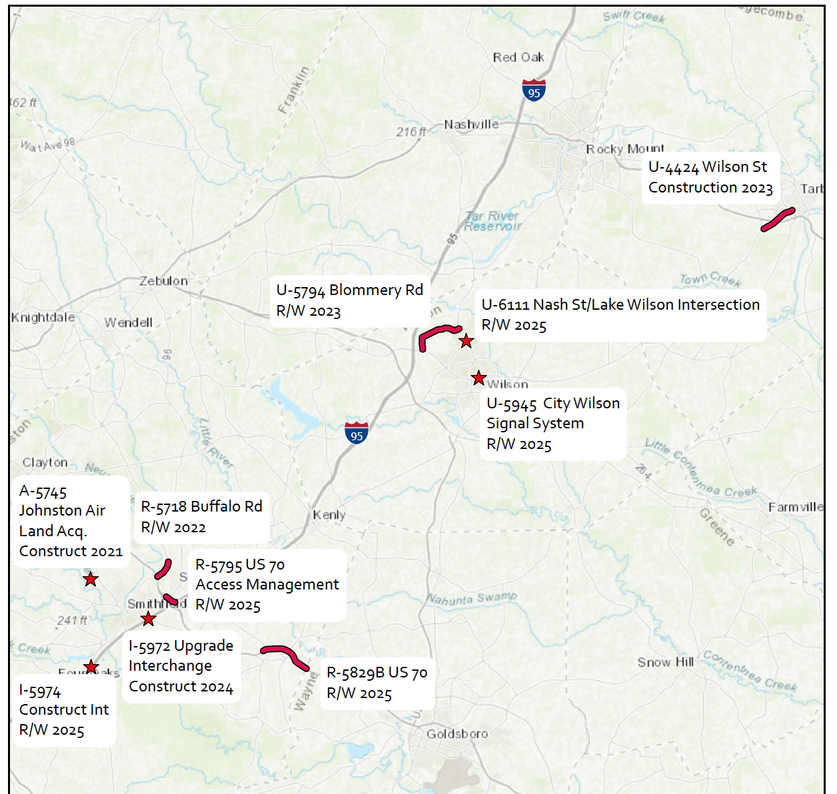
UCPRPO TCC Meeting
Edgecombe County - Johnston County – Nash County – Wilson County
September 14, 2021
7. STI Prioritization P6 Update
Upper Coastal Plain RPO
STI STIP FY2020-2029
Committed Projects
Note: List does not include
Non STI projects
i.e. bridge projects
projects under construct
safety projects
pavement rehab

Slide 19
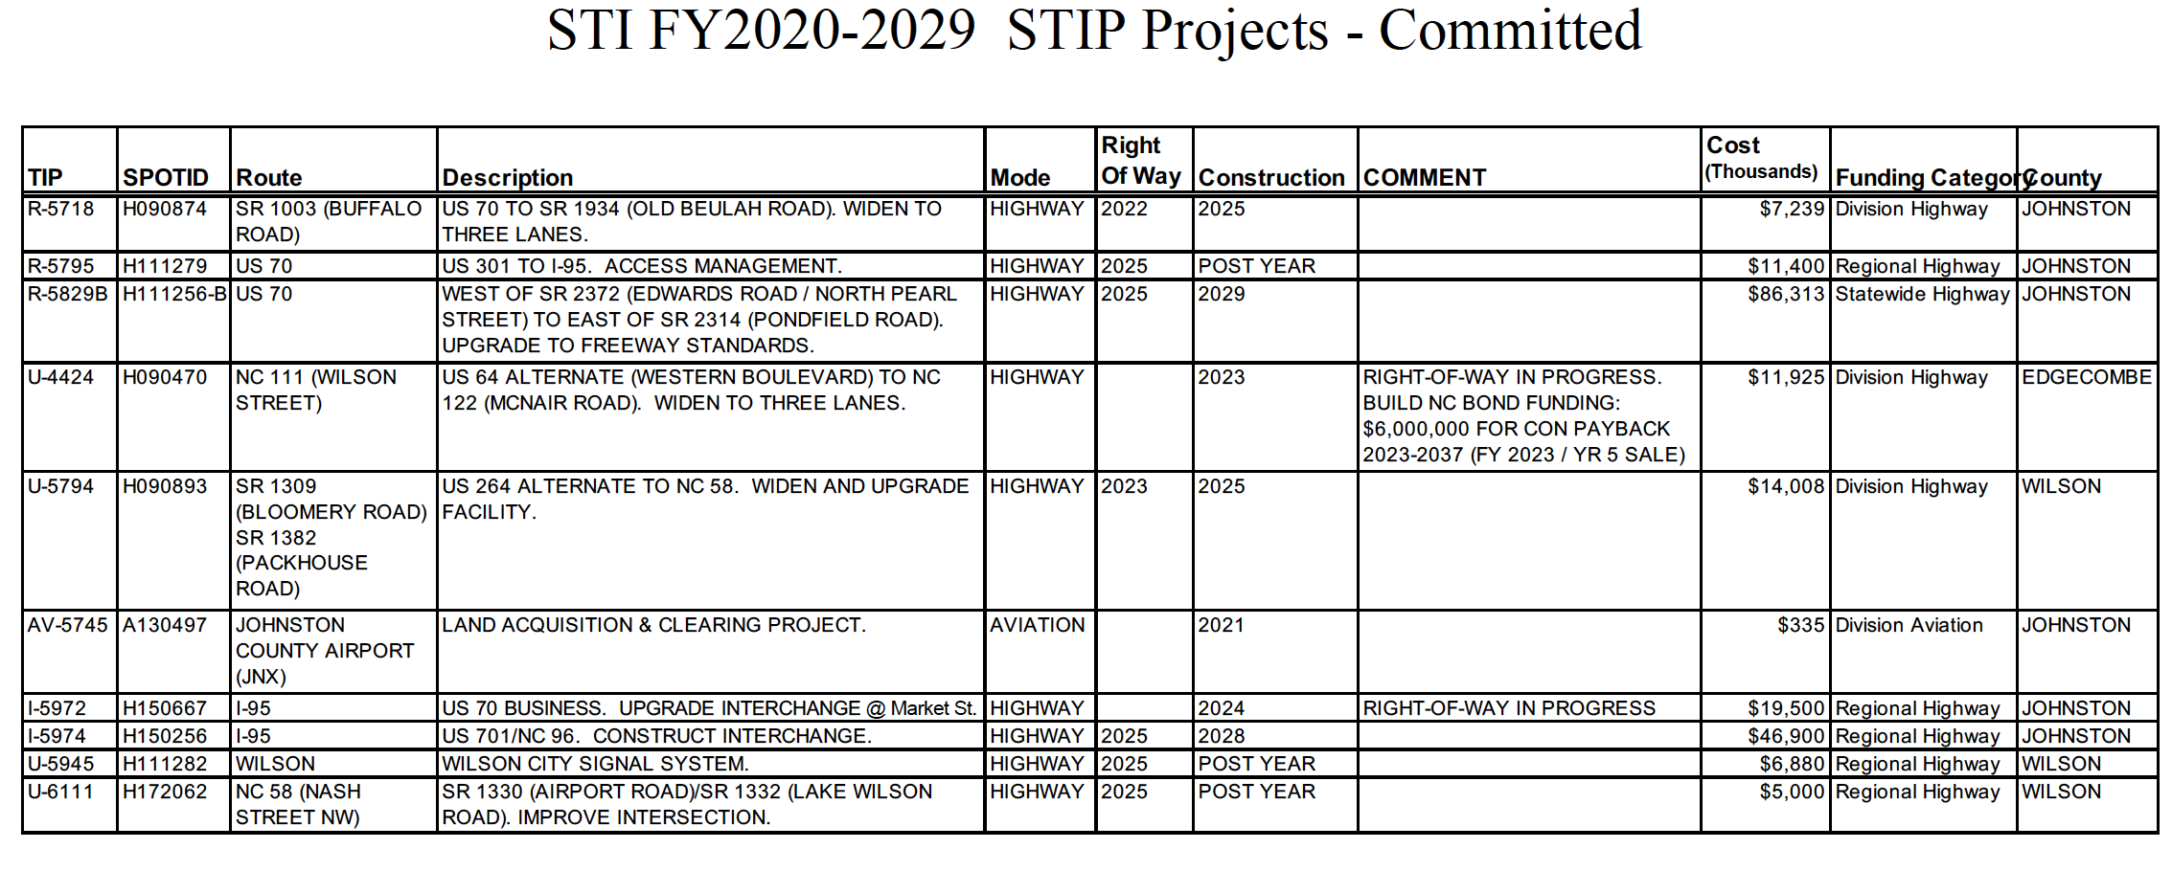
UCPRPO TCC Meeting
Edgecombe County - Johnston County – Nash County – Wilson County
September 14, 2021
7. STI Prioritization P6 Update
Note: List does not include Non STI projects i.e. bridge projects, projects under construction, safety projects, and pavement rehabilitation projects.

Slide 20
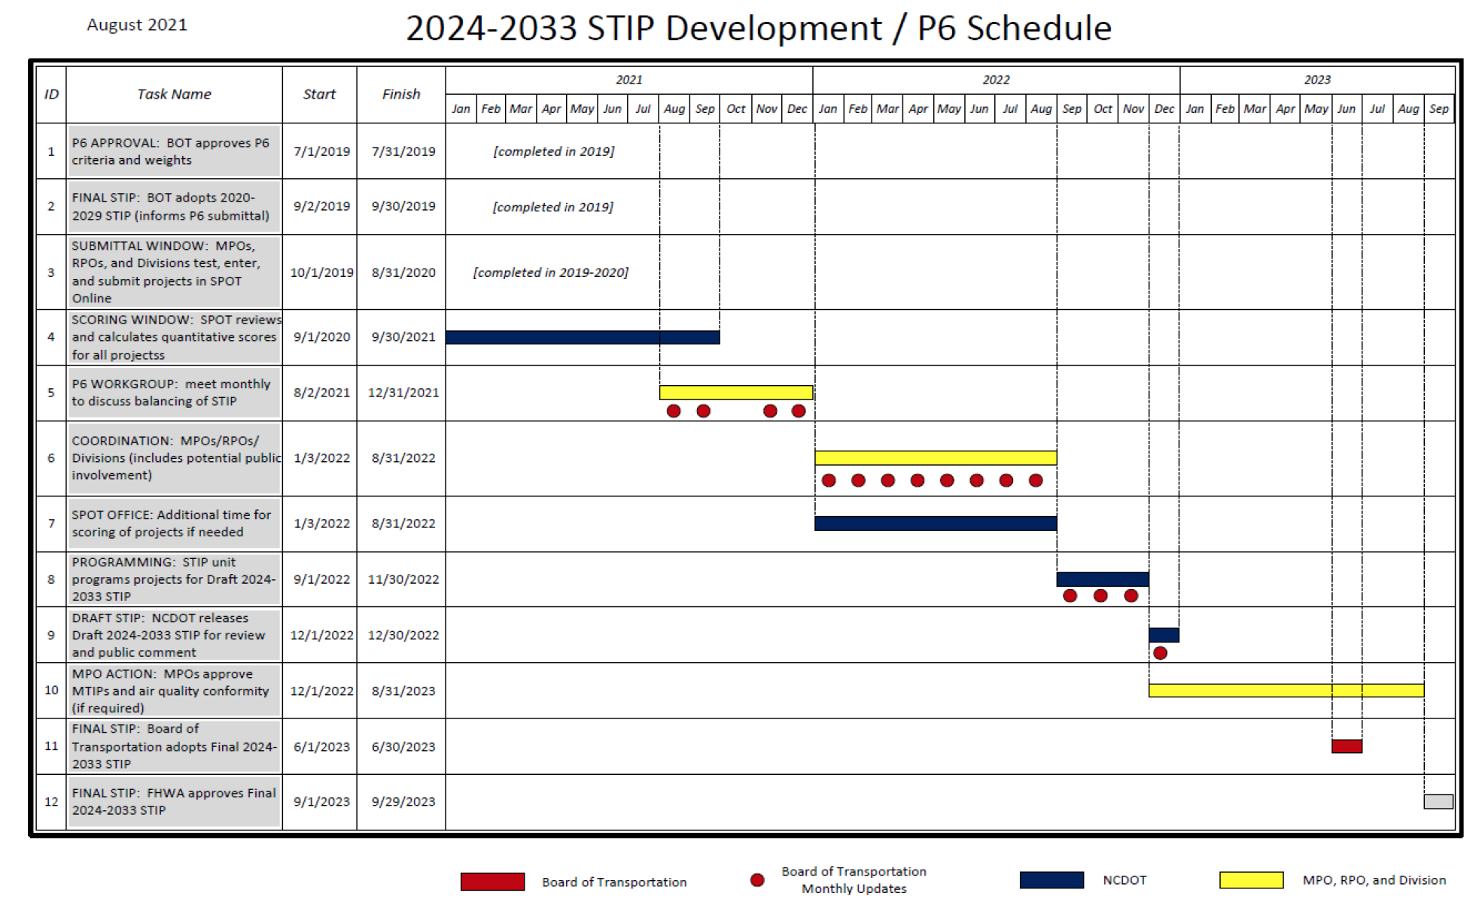
UCPRPO TCC Meeting
Edgecombe County - Johnston County – Nash County – Wilson County
September 14, 2021

Slide 21
UCPRPO TCC Meeting
Edgecombe County - Johnston County – Nash County – Wilson County
September 14, 2021
8. Call for CMAQ Projects
Only for Edgecombe, Nash and Johnston Counties
The UCPRPO has $603,240 to allocate for CMAQ projects for FY2023.
- CMAQ = Congestion Mitigation & Air Quality
- Funds require a 20% match and must be managed or administered by funding recipient. Program is a reimbursement program not a grant.
Examples of CMAQ projects include:
- Bicycle and pedestrian facilities and programs (most popular)
Transit improvements
Transportation control measures
Congestion reduction and traffic flow improvements

Slide 22
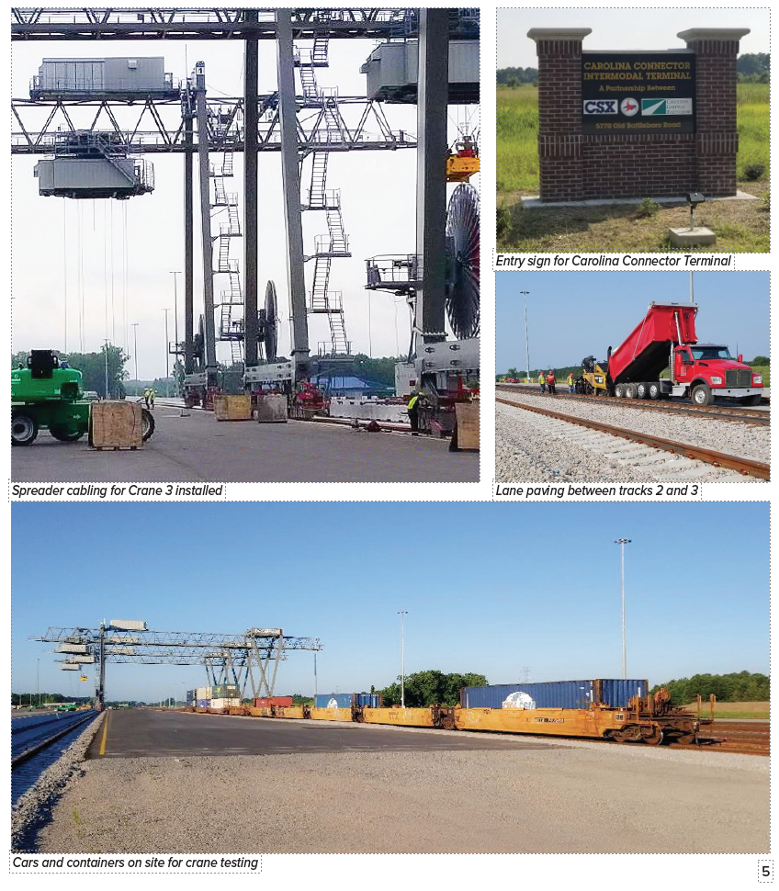
UCPRPO TCC Meeting
Edgecombe County - Johnston County – Nash County – Wilson County
September 14, 2021
9. CCX Update
Construction is ongoing at the Carolina Connector (CCX) intermodal terminal in Edgecombe County. Work continues to finalize, test and commission the cranes. Last touches are being applied to lanes, parking, tracks and facility grounds as CSX, the Carolina Gateway Partnership and NCDOT anticipate an October opening of the facility.
Ribbon cutting is anticipated the first or second week of October.

Slide 23
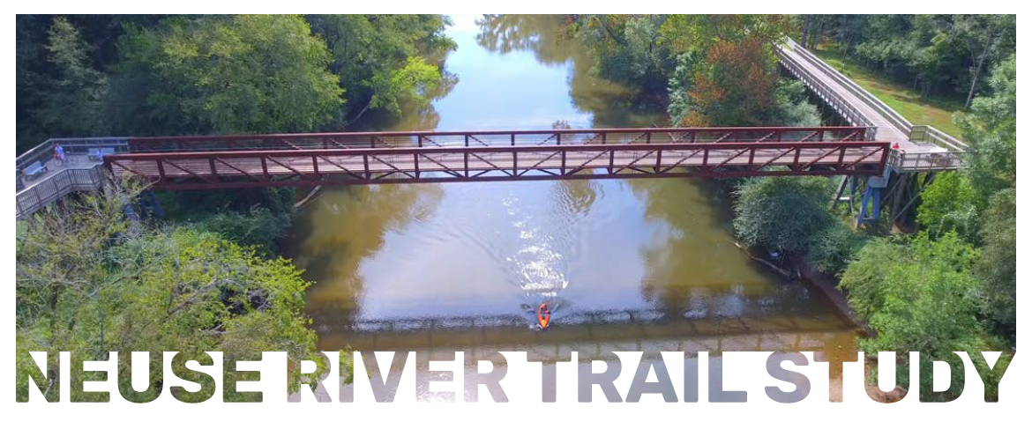
UCPRPO TCC Meeting
Edgecombe County - Johnston County – Nash County – Wilson County
September 14, 2021
10. Neuse River Trail Clayton to Smithfield Updated
The Raleigh based McAdam’s Company was selected to complete the Neuse River Trail Study.
We are currently finalizing detailed scope and are in contract negotiations. Goal is to begin work by November.

Slide 24
UCPRPO TCC Meeting
Edgecombe County - Johnston County – Nash County – Wilson County
September 14, 2021
11. US 70 Commission
No Report. The Commission has not met since our last meeting.

Slide 25
UCPRPO TCC Meeting
Edgecombe County - Johnston County – Nash County – Wilson County
September 14, 2021
12. Hwy 17/64 Association
No Report. The Association has not met since our last meeting.
Marc Finlayson, Director of the Hwy 17/64 Association is planning to attend the next TAC meeting 9/22/21.

Slide 26
UCPRPO TCC Meeting
Edgecombe County - Johnston County – Nash County – Wilson County
September 14, 2021
13. Legislative Update
NC State budget:
NC House and Senate currently negotiating the NC State budget to reach concurrence.
Both the House and Senate budgets passed each chamber with a veto proof majority.
Note the House proposed budget has an allocation of nearly $184 million in “grants and aid” to local communities. Funding is from transferring $500 million from the General Fund to NCDOT as “pass through money” to local communities and other designated purposes, i.e. fixing potholes, maintenance, etc.
Senate Pro Tempore (Berger) stated “I don’t see us getting to the [budget] finish line before the end of September”, source N&O – September 1, 2021.

Slide 27
UCPRPO TCC Meeting
Edgecombe County - Johnston County – Nash County – Wilson County
September 14, 2021
13. Legislative Update
The US Senate’s recently passed Infrastructure and Investments Jobs Act includes:
$110B for Roads, Bridges, and Major Projects
$11B for transportation safety programs
$89.99B in guaranteed funding for public transit projects over next 5 years
$66B for passenger rail
$7.5B for EV infrastructure to install charging stations
$5B in zero emissions and clean busses and $2.5B for ferries
$1B to aid in reconnecting divided communities
$17B in port infrastructure
$25B in airports

Slide 28
UCPRPO TCC Meeting
Edgecombe County - Johnston County – Nash County – Wilson County
September 14, 2021
13. Legislative Update
The US Senate’s recently passed Infrastructure and Investments Jobs Act includes (cont’d):
$100B for resilience and western water infrastructure
$55B for clean drinking water
$65B for high-speed internet
$21B for environmental remediation
$65B investment in clean energy transmission
The Infrastructure and Investments Jobs Act must still be passed by the House and signed by the President.

Slide 29
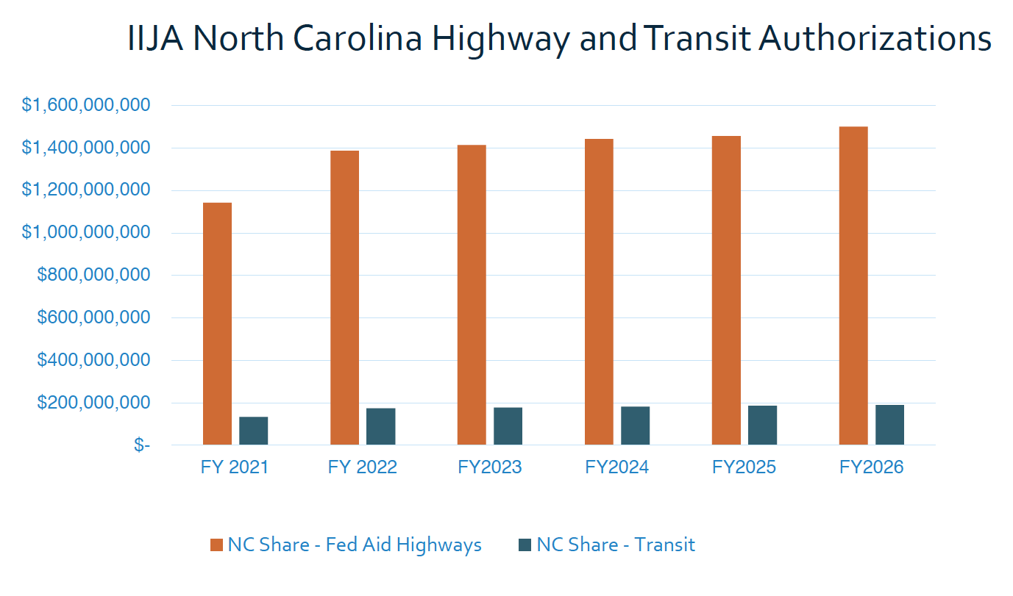
UCPRPO TCC Meeting
Edgecombe County - Johnston County – Nash County – Wilson County
September 14, 2021
13. Legislative Update
The US Senate’s recently passed Infrastructure and Investments Jobs Act: Estimated Impacts on North Carolina
24% increase for
the First year FY22
($300M +-)
2% increase for
next years through
FY26 ($3M+-)

Slide 30
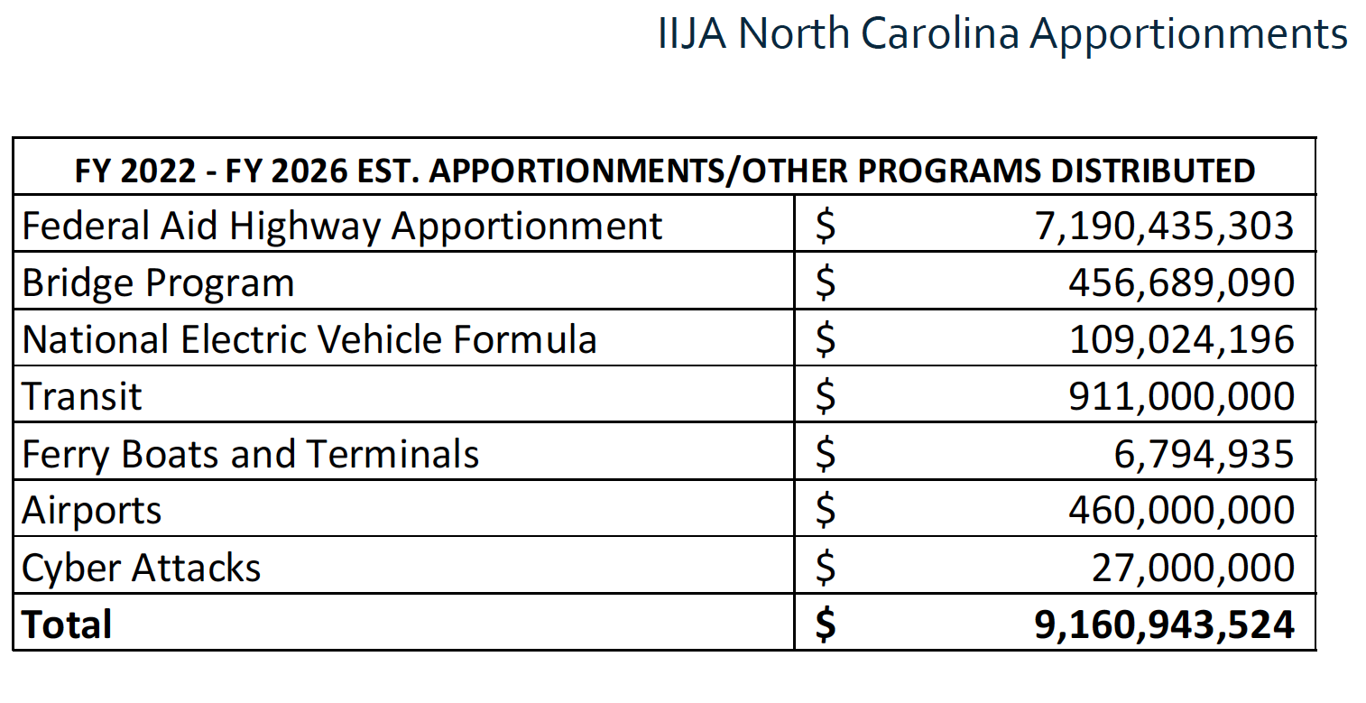
UCPRPO TCC Meeting
Edgecombe County - Johnston County – Nash County – Wilson County
September 14, 2021
13. Legislative Update
The US Senate’s recently passed Infrastructure and Investments Jobs Act – Estimated Impacts on North Carolina

Slide 31
UCPRPO TCC Meeting
Edgecombe County - Johnston County – Nash County – Wilson County
September 14, 2021
14. NCDOT Division 4 Update
NCDOT Division 4 Update
Bobby Liverman, P.E.
District Engineer
Division 4 District 2
Nash and Wilson Counties
252-462-2550
Blliverman@NCDOT.GOV

Slide 32
UCPRPO TCC Meeting
Edgecombe County - Johnston County – Nash County – Wilson County
September 14, 2021
15. NCDOT Transportation Planning Division (TPD) Update
TPD Update by:
Carlos Moya-Astudillo, EI
Planning Engineer, TPD
919-707-0934
cemoya@ncdot.gov

Slide 33
UCPRPO TCC Meeting
Edgecombe County - Johnston County – Nash County – Wilson County
September 14, 2021
16. TCC Member Comments
Any additional TCC Member Comments…………

Slide 34
UCPRPO TCC Meeting
Edgecombe County - Johnston County – Nash County – Wilson County
September 14, 2021
17. Public Comment
Public Comment

Slide 35
UCPRPO TCC Meeting
Edgecombe County - Johnston County – Nash County – Wilson County
September 14, 2021
Dates for future meetings
Future TCC Meeting Dates:
November 2, 2021
January 4, 2022
March 1, 2022
May 3, 2022

Slide 36
UCPRPO TCC Meeting
Edgecombe County - Johnston County – Nash County – Wilson County
September 14, 2021
Need a motion and a second for:
ADJOURNMENT
and
Roll Call
Next meeting: November 2, 2021

